Slide 1
16.885: Medium-Fidelity Solar Airplane MDO
Peter Sharpe
2/20/2020

Slide 2
Key Question
We have two missions:
Track storm
Stationkeep (sizes aircraft, we only care about this)
What happens if you not only optimize the design of the aircraft, but you also optimize how and where you fly the aircraft?
There is diurnal cycling of power into the system; it’s likely that the optimal trajectory takes advantage of this
Altitude cycling
Airspeed cycling
How much of a benefit is this?
How do you design a multipoint-optimized airplane? Is it worth it?

Slide 3

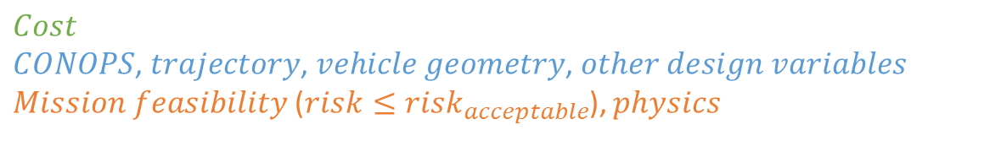
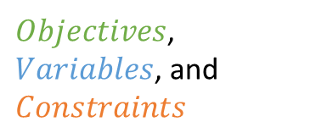
Problem Formulation
$Objectives$, $Variables$, and $Constraints$
Aircraft design is fundamentally an optimization problem:
Minimize:
With respect to:
Subject to:
$$Cost$$
$CONOPS$, $trajectory$, $vehicle geometry$, $other design variables$
$Mission feasibility$ ($risk≤risk_{acceptable}$), $physics$
Typical
Aircraft
Solar Aircraft
Minimize:
With respect to:
Subject to:
$$TOGW$$
$Trajectory$, $vehicle geometry$, $power systems$, $CONOPS$, $etc.$
$Mission feasibility on worst day$, $physics$
Coupled Design and Trajectory Optimization Problem:
Highly multidisciplinary:
Problem size (tens of thousands of nonlinear, nonconvex variables and constraints)
The circle-closing problem!
At hundreds of collocation points over a 24-hour modeling window
Aerodynamics
Structures
Propulsion
Stability & Control
Trajectory/Dynamics (2D)
Weights
Power Systems
Automatic-differentiable framework!

Slide 4
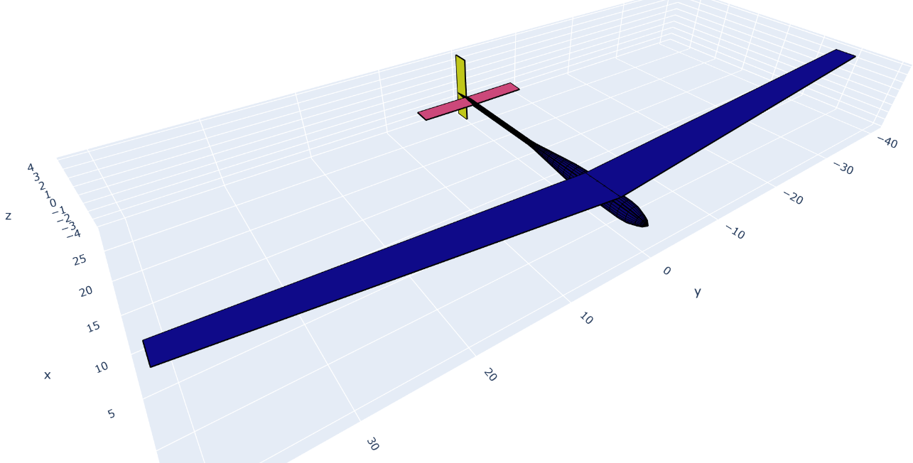
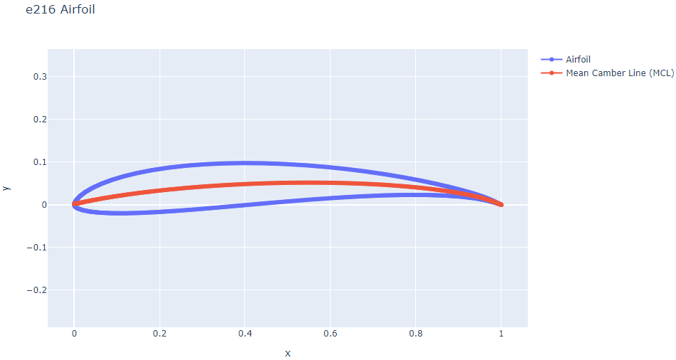
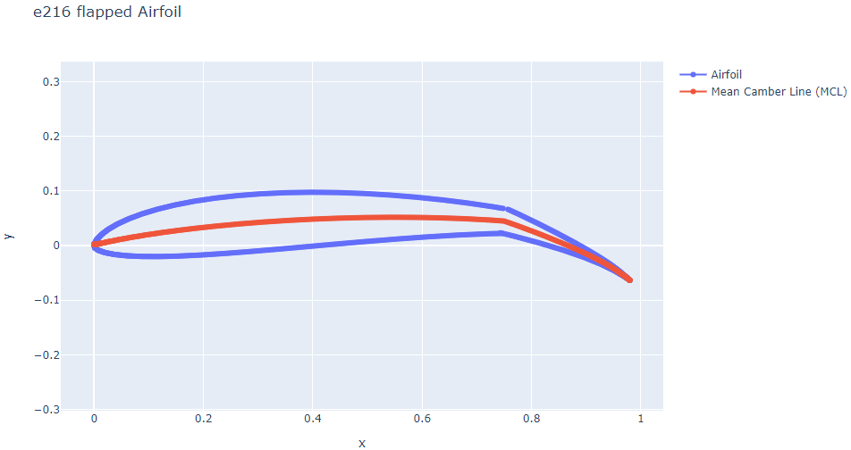
Models: Geometry
Object-oriented aircraft geometry stack built in Python
Fully modular
Wings, fuselages, airfoils
Lofting, parameter calculation (volume, wetted area, etc.)
Thin surface or solid
3D Tri/quad surface meshing
Free variables
Wing sizing (span, chord, taper, etc.)
Tail sized by volume coefficients

Slide 5
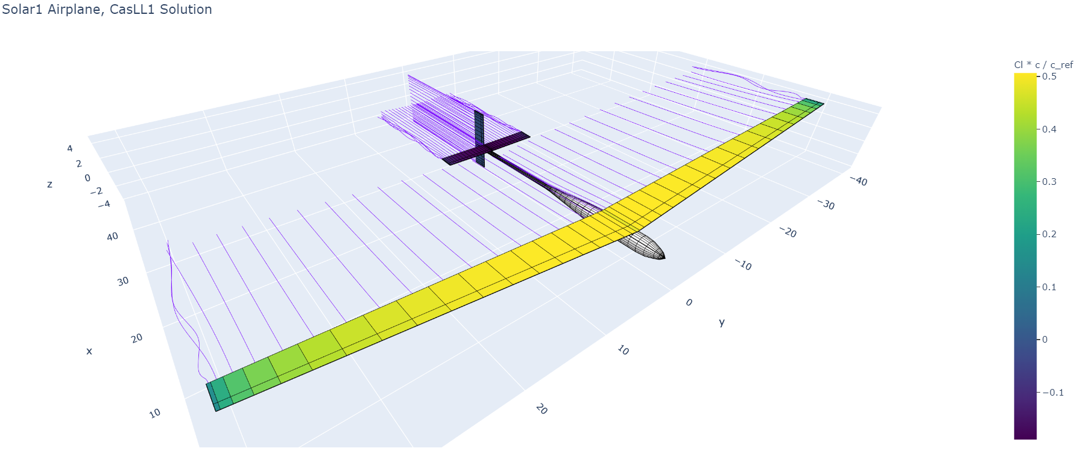
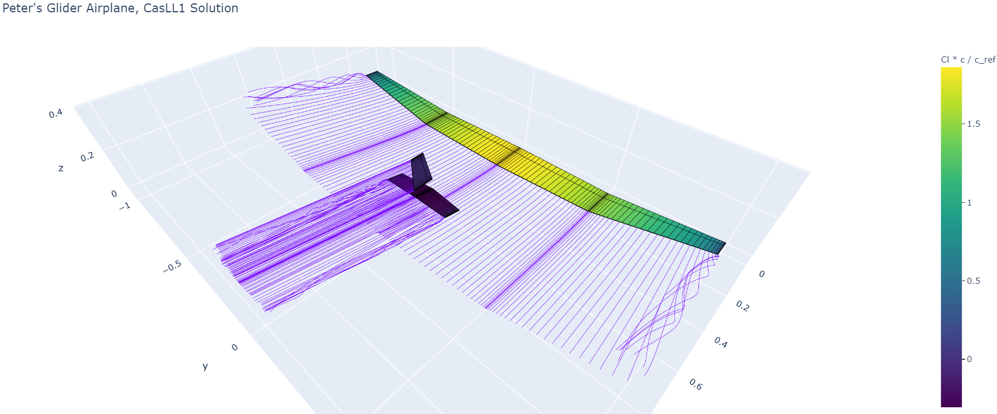
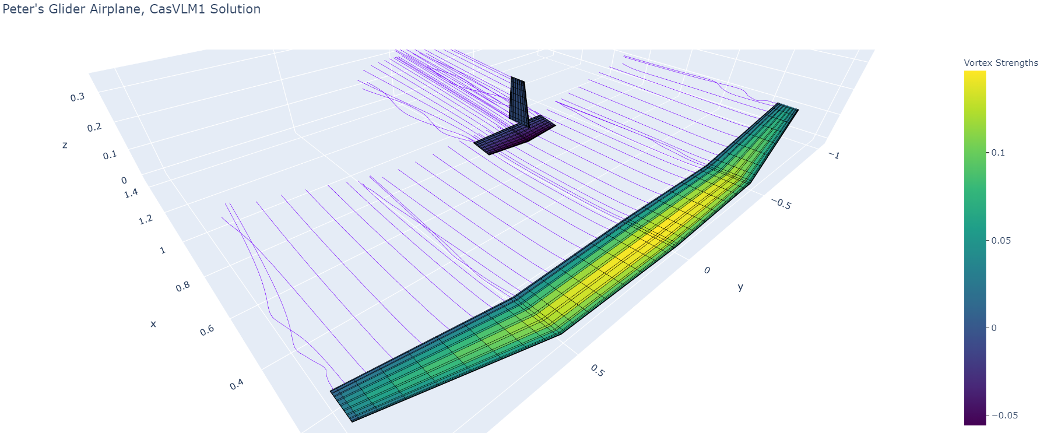
Models: Aerodynamics
Aerodynamics solved simultaneously at every collocation point
Options:
Traditional lift/drag/moment accounting
Fully nonlinear lifting-line model
Coupled viscous effects (significant Reynolds effects)
Local stall modeling, local forces
Fuselage modeling (line source + doublet)
~50 ms runtime
Vortex-lattice model
~150 ms runtime
All models:
Simultaneous Analysis and Design (SAND)-compatible
End-to-end automatic differentiable
Optimization
Stability derivatives, eigenmode analysis
Higher-order gradients (operator space closed under differentiation)

Slide 6
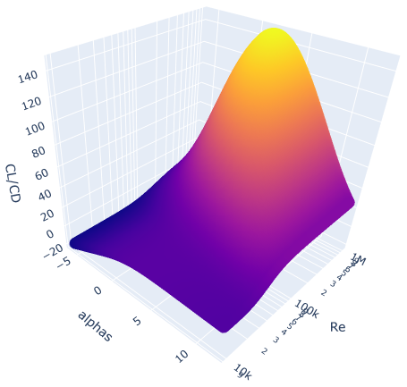
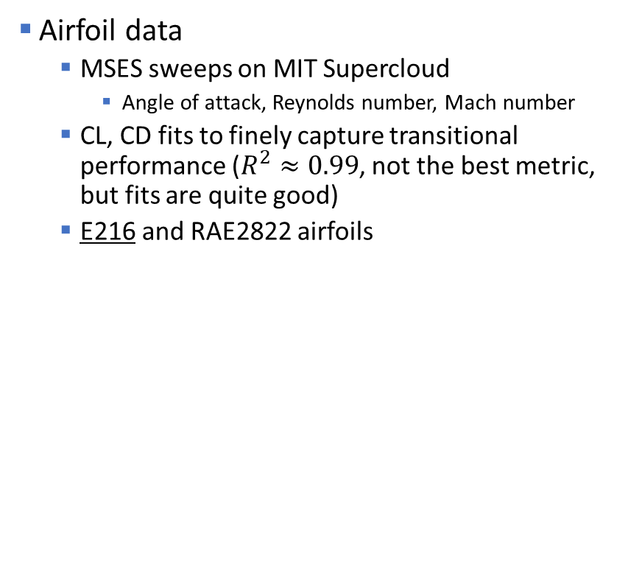
Models: Aerodynamics
E216 Airfoil: L/D Ratio
Airfoil data
MSES sweeps on MIT Supercloud
Angle of attack, Reynolds number, Mach number
CL, CD fits to finely capture transitional performance ($R^{2}≈0.99$, not the best metric, but fits are quite good)
E216 and RAE2822 airfoils

Slide 7
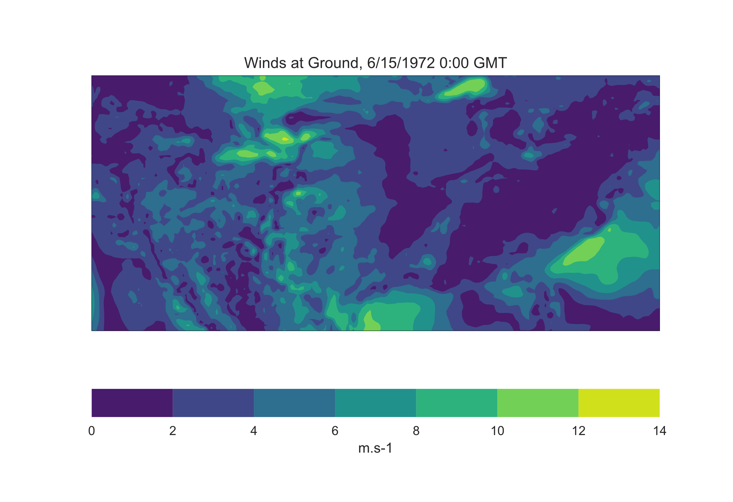
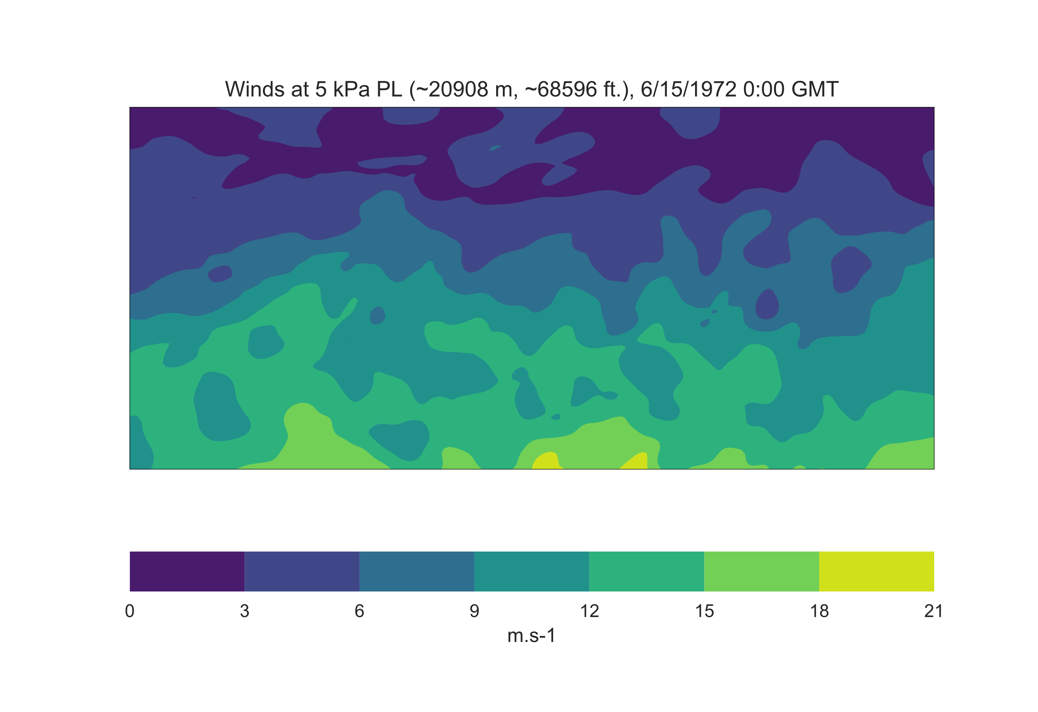
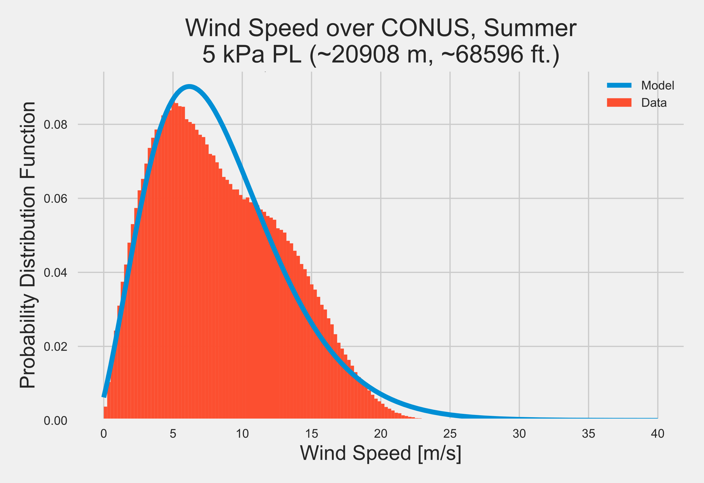
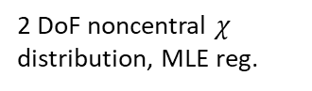
Models: Atmosphere and Wind
Hunch: diurnal cycling of wind speed?
Atmosphere
1976 COESA model
Pressure, temperature, density (derived), Sutherland viscosity
Wind speed
Currently assumed to be constant at 29 m/s (global, year-round 99% winds @ 65kft, from Kevin Uleck)
Future models
Obtained API keys for the ECMWF ERA5 database
Global atmospheric data at kilometer-scale resolution going back 50 years
9 petabytes of data!
Dataset trimmed to the most-relevant 12 GB
Work in progress: regression to altitude, time of day, and latitude
Preliminary findings: 99% percentile wind speed over CONUS @ ~69 kft, July-Aug., is 19.5 m/s
2 DoF noncentral $χ$ distribution, MLE reg.
Based on an analysis of 1.2M samples
0.08% of the 12 GB dataset!

Slide 8
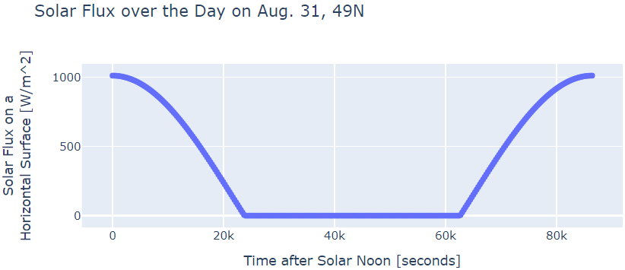
Models: Power Systems
Implemented Ed Lovelace’s presentation
Key Assumptions
Battery
Cell specific energy: 265 Wh/kg (Odysseus)
80% allowable depth of discharge (for reserve, cycling, voltage cliff)
Battery pack is 70% cells by weight (module HW, BMS, pack installation, thermal management, case, etc.)
Realizable specific energy: 148.4 Wh/kg
Accounting for wire weight assuming 10 AWG aluminum wire
Solar cells:
Realizable efficiency: 20.5% (temp. effects, spectral losses, multi-junction effects, MPPT losses, etc., conservative case)
Area density: 0.30 kg/m² (Burton, conservative case)
Irradiance
Day of year, time of day, latitude, orbital eccentricity, incidence angle losses

Slide 9
Models: Propulsion
Dynamic disc-actuator theory
Propeller efficiency of 0.7
Motor efficiency of 0.85
Propeller diameter and number of propellers left as free variables
Propulsion mass
Motor: 4140 W/kg (Burton)
Motor mass doubled to account for mounting and installation weight (Raymer)
Propeller mass:
Curve fit to carbon fiber paramotor propellers (similar disc loading, though a bit smaller size)
ESC mass:
Scraped the Hobbyking ESC listings and ran curve fits to ESCs in the 8s 100A range

Slide 10
Models: Weights
Weight Breakdown
Payload (30 kg)
Structures
Structural mass fraction guess: 0.25 – 0.31 (baseline: 0.31, Odysseus)
Propulsion
Motor, propeller, motor mounts
Power Systems
Batteries (and associated hardware), solar panels (and associated hardware), wire weight
Avionics
Flight controller, sensors, communications, servos

Slide 11
Models: Dynamics
300 equally-spaced collocation points across a 24-hour cycle
Midpoint-method integration (second-order accurate)
Convergence testing indicates >200 collocation points is sufficient
Speed/Flight Path Angle velocity parameterization
Conserves energy more accurately than Cartesian parameterization
Angle of attack and thrust left as decision variables (hence, short-period modes neglected)
Optimal control problem

Slide 12
Optimization
Jacobian computed for objective and constraints, Lagrangian hessian computed via automatic differentiation
Passed into IPOPT, an open-source interior point solver
Performance for Various Aerodynamics Models
Problem (aerodynamics: “workbook” method):
3009 variables, 6313 constraints, 21903 constraint-variable interactions
Solves in 2.14 seconds
Problem (aerodynamics: nonlinear viscous lifting line method):
3208 variables, 5013 constraints, 29603 constraint-variable interactions
Solves in 147.8 seconds
Would likely be much faster with a good preconditioner
How much does the aero model matter?
Across a variety of different assumptions, the mean absolute difference in the objective function (TOGW) at the optimum is 1.1%

Slide 13
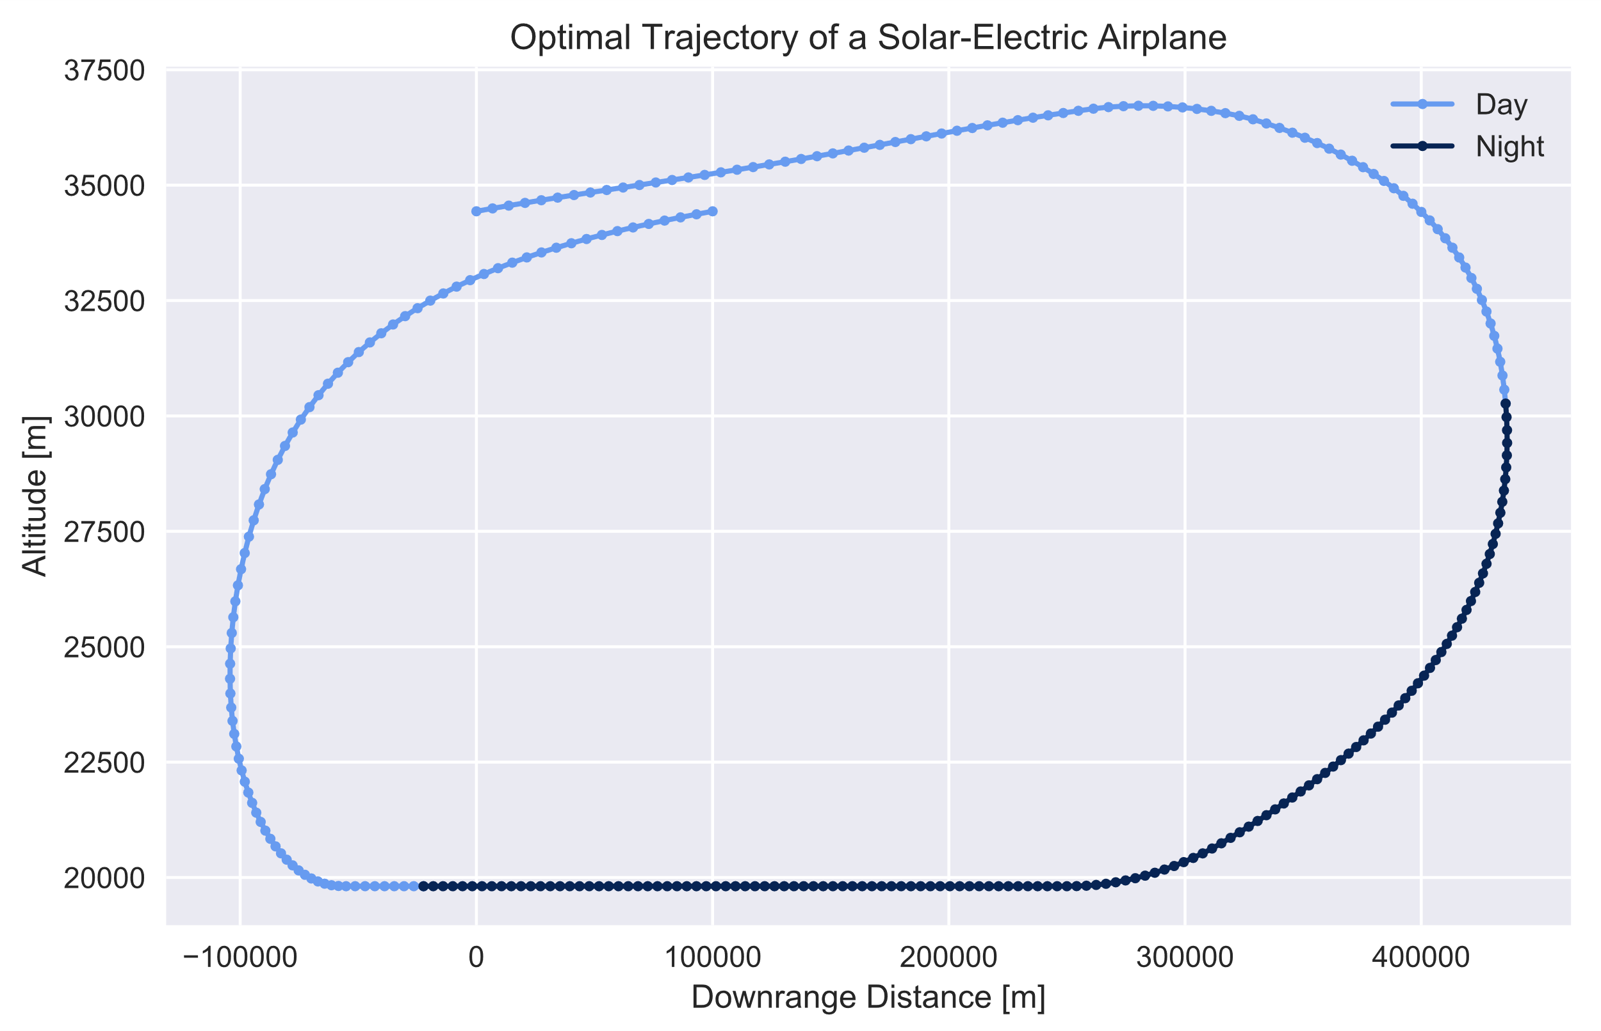
Results
Trajectory
Day 1, solar noon
Day 2, solar noon
Headway requirement
Dusk
Ambient wind field
Dawn
Altitude-constrained

Slide 14
Results
TOGW [kg], Conservative
 |  | Altitude Cycling?
 |  | No | Yes
Airspeed Cycling? | No | DNC* | DNC*
 | Yes | DNC* | 272.5
TOGW
Two sets of tech assumptions:
Conservative (assumptions listed previously)
Optimistic
TOGW [kg], Optimistic
 |  | Altitude Cycling?
 |  | No | Yes
Airspeed Cycling? | No | 236.5 | 204.6
 | Yes | 163.2 | 108.7
* DNC = “Does Not Close”

Slide 15
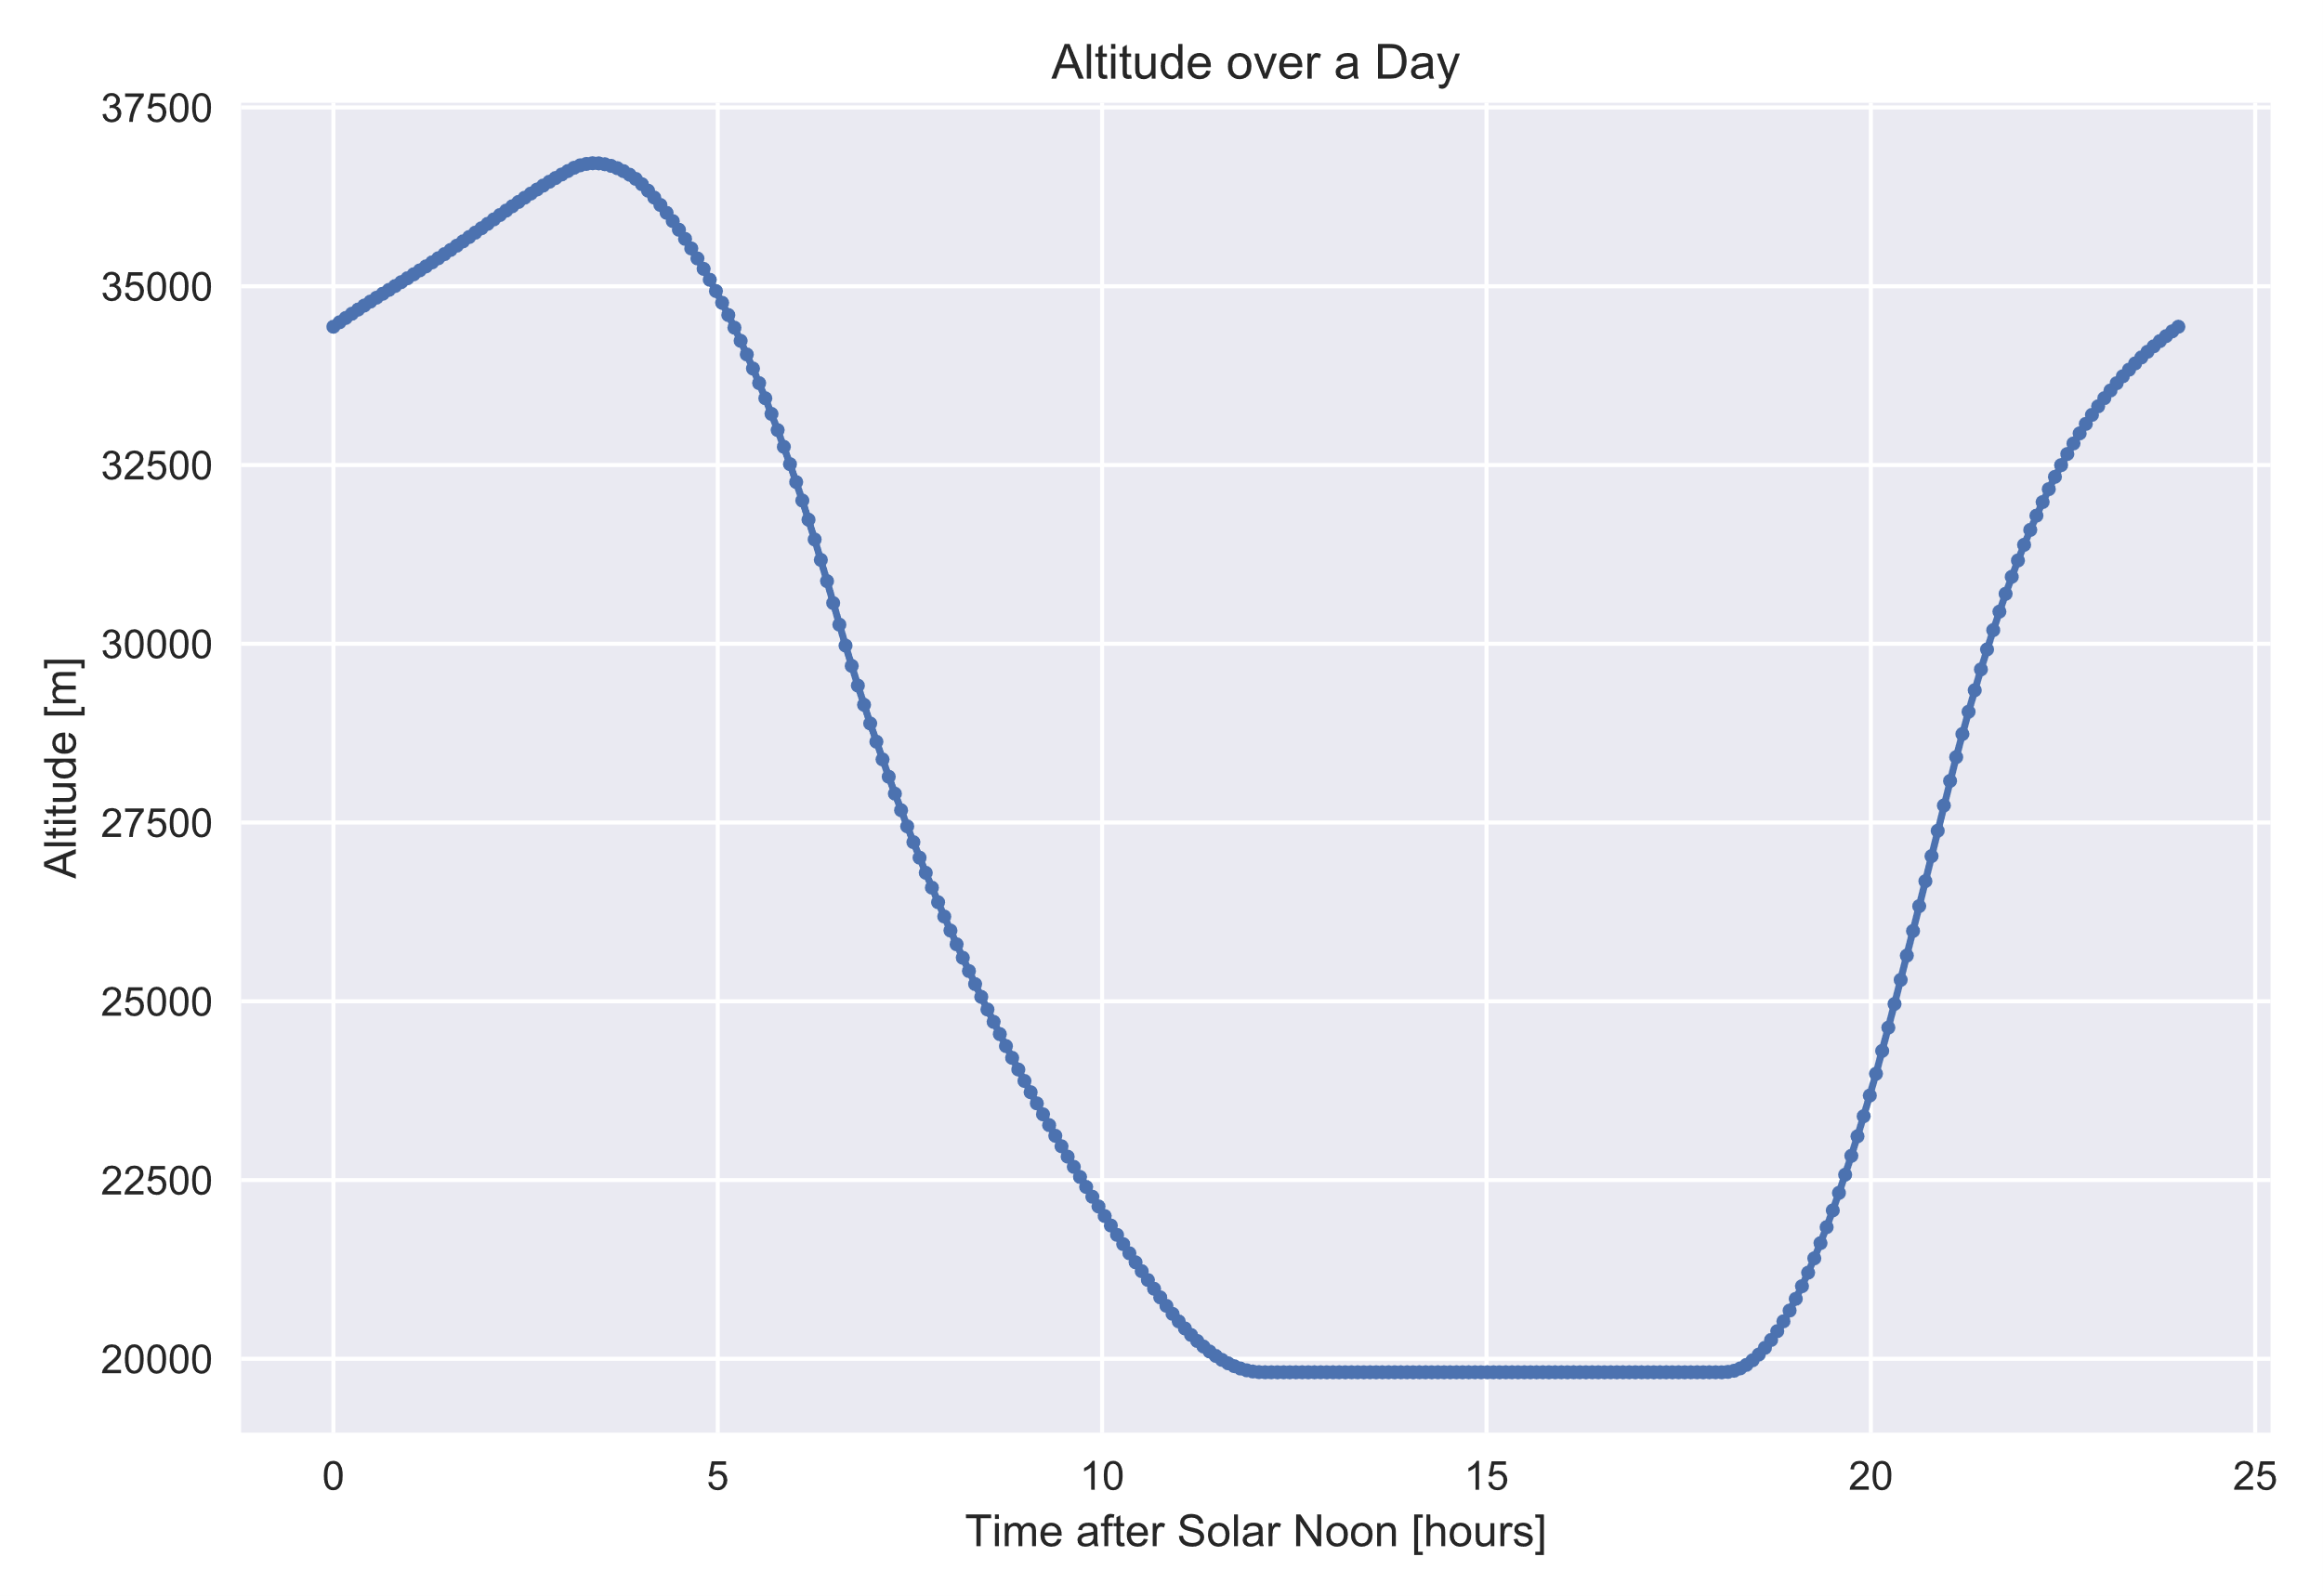
Results

Slide 16
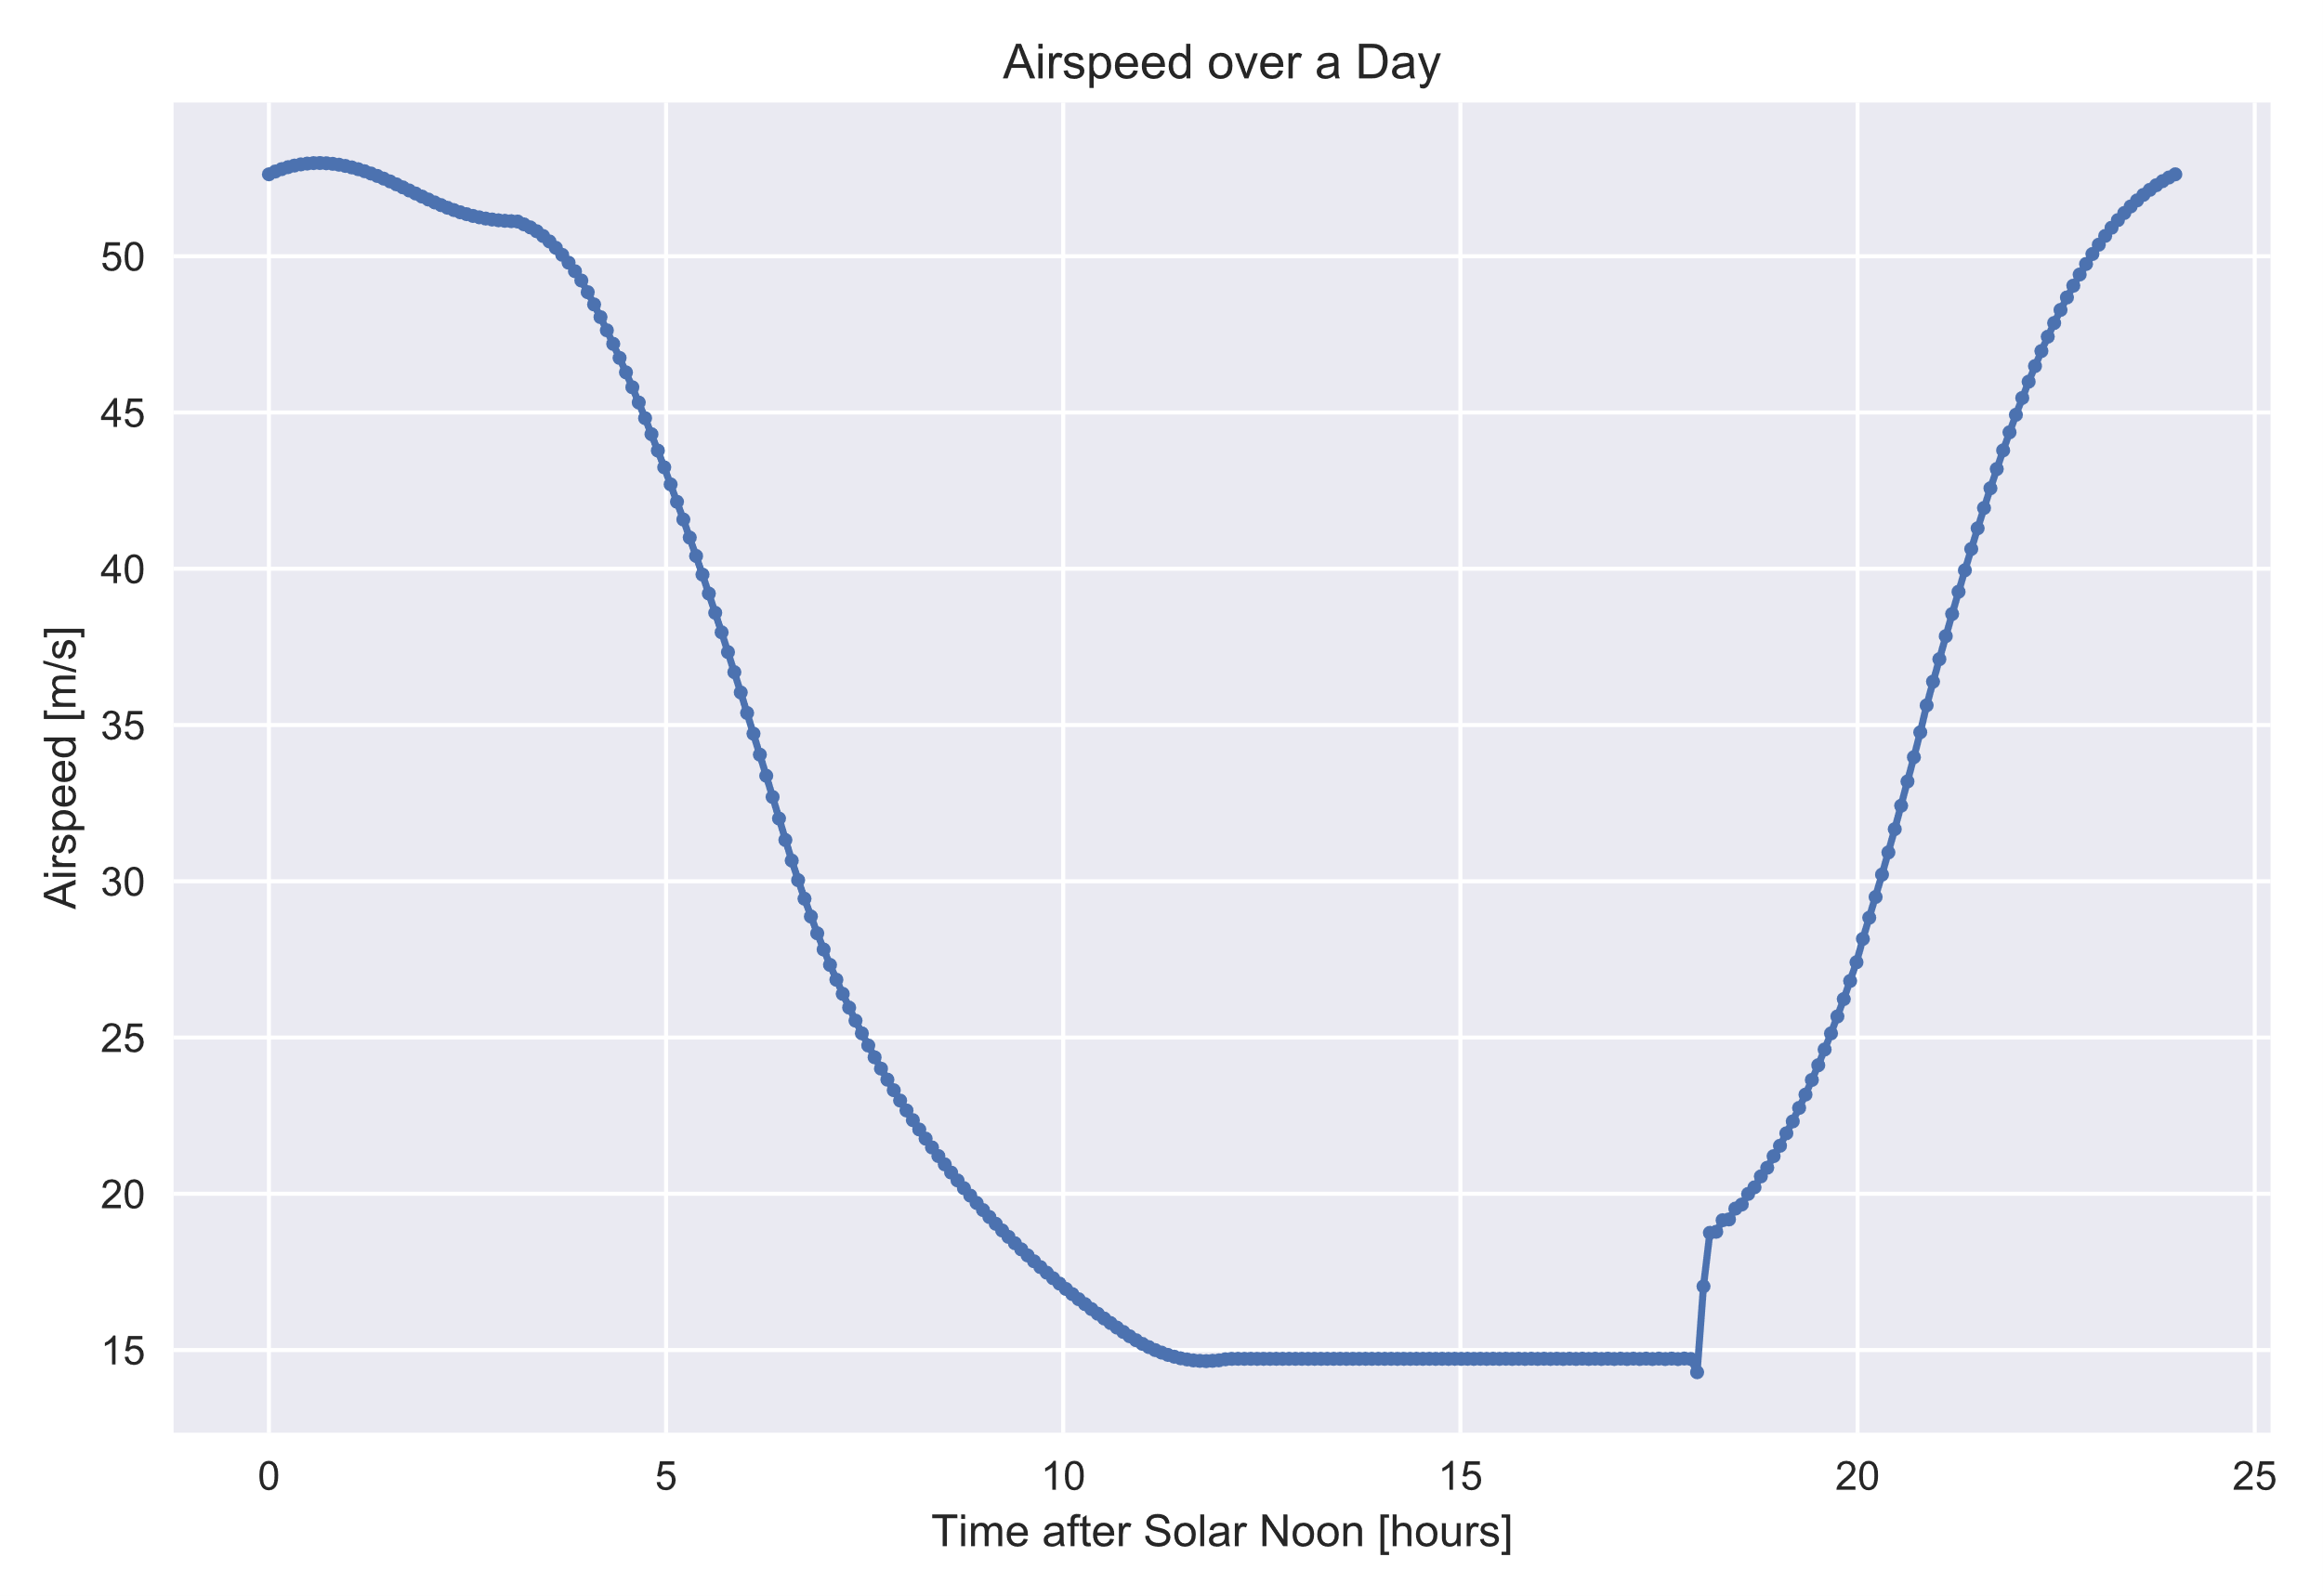
Results

Slide 17
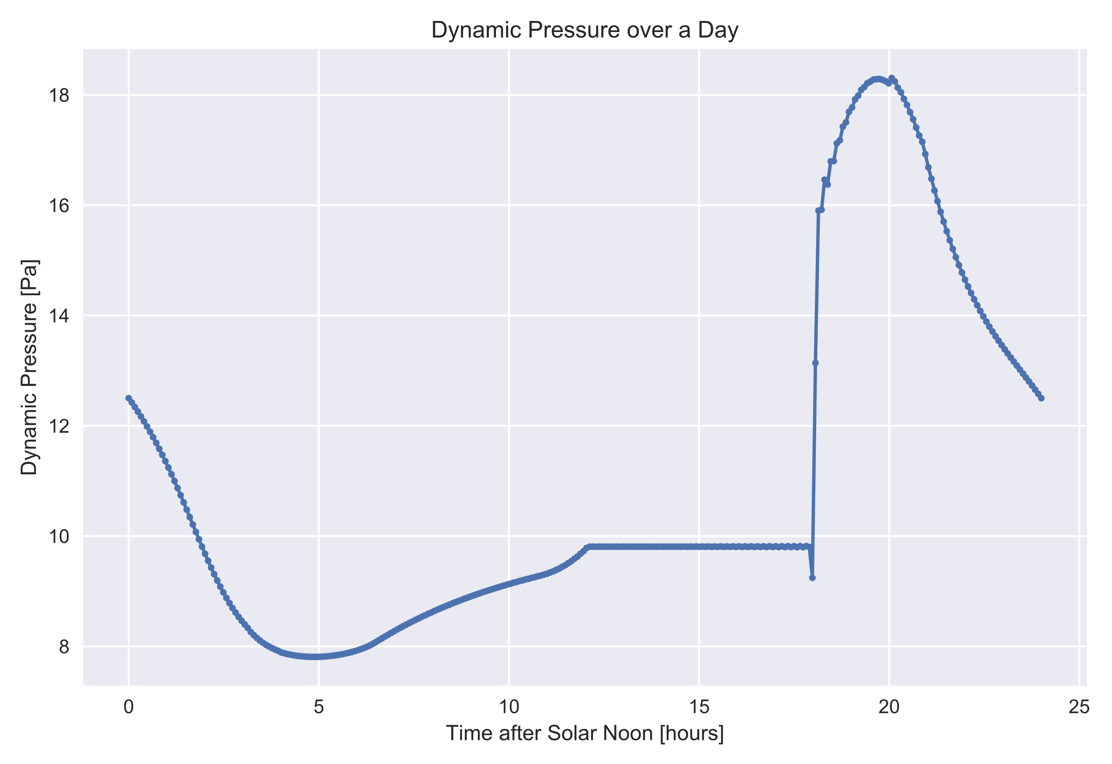
Results

Slide 18
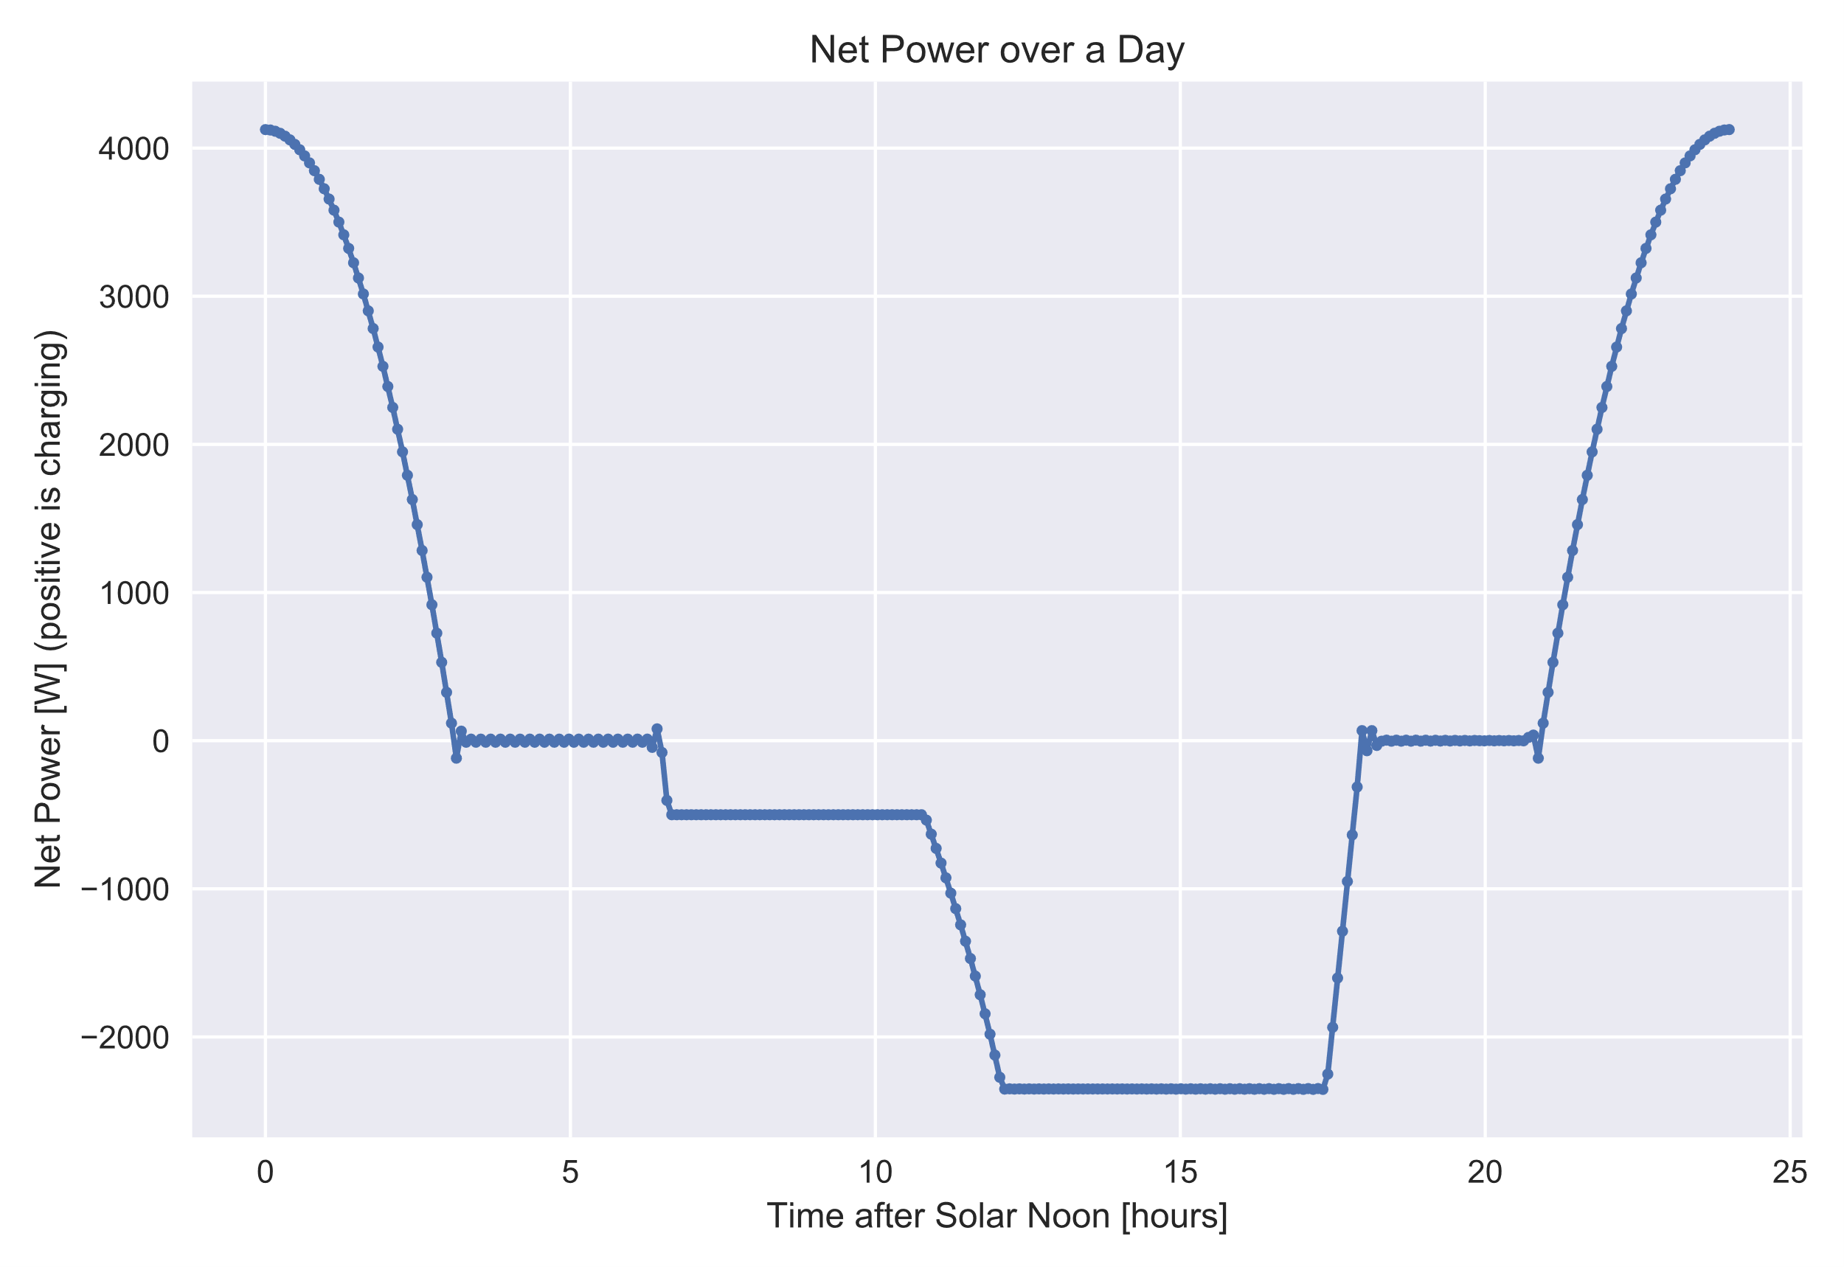
Results

Slide 19
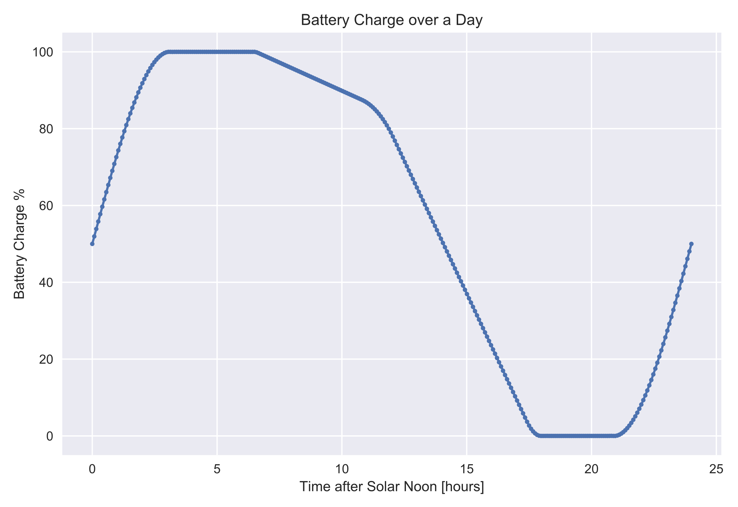
Results

Slide 20
Takeaway
There are huge benefits for solar aircraft if you do coupled design and trajectory optimization!
Considerations:
Winds (although we designed to 29 m/s, and the 99th percentile CONUS summer 24-hour wind speed @ 69 kft is around 19.5 m/s)
Time-of-day effects could help or hurt
Propeller advance ratio, RPM (solvable)
Variable pitch, gearbox?
Temperature is not an issue
Stretching structural weight assumptions at the low end
Ascent
Notes
Solar panel efficiency & weight matters little compared to battery weight

Slide 21

New Optimization Strategies: Motivation
$Objectives$, $Variables$, and $Constraints$
Aircraft design is fundamentally an optimization problem:
Minimize:
With respect to:
Subject to:
$$Cost$$
$CONOPS$, $trajectory$, $vehicle geometry$, $other design variables$
$Mission feasibility$ ($risk≤risk_{acceptable}$), $physics$
Typical
Aircraft
Firefly
Maximize:
With respect to:
Subject to:
$$Range$$
$Trajectory$, $vehicle geometry$, $other design variables$
$Packaging, CONOPS$, $physics$
Challenges
Highly multidisciplinary:
Problem size (tens of thousands of variables and constraints)
The circle-closing problem!
Aerodynamics
Structures
Propulsion
Stability & Control
Trajectory/Dynamics
Weights
Packaging/Deployment

Slide 22
New Optimization Strategies: Motivation
Design loop! (Implicit)
Guess and check?
The circle-closing problem!
Aerodynamics
Scales very poorly…
Packaging / Deployment
Structures
Driving dependencies (just to 1st order!)
We need to implicitly solve for all disciplines simultaneously!
Weights
Geometry
Propulsion
Range
Trajectory / Dynamics
Stability & Control
Notes:
Do not pass go, do not collect $200

Slide 23
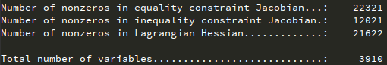
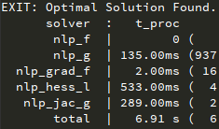
New Optimization Strategies: Why Do We Care?
Example Problem:
Firefly design optimization
8 disciplines
3910 variables
8420 constraints
34321 constraint-variable interactions
Nonlinear, nonconvex
6.91 seconds to solve on a laptop.
With new methods, we can solve these complex problems extremely quickly.
Fast enough for interactive design

Slide 24
Backup: Why not use GPKit?
Similarities
AD-accelerated optimization and GPKit are similar in that they are both optimization-first approaches to engineering design
Performance on GP-compatible problems is identical in terms of results, nearly identical in terms of speed
“Simple Wing” example from GPKit documentation:
GPKit: 41.9 milliseconds
AD: 32.9 milliseconds
Advantages of AD
GPKit restricts you not only to convex problems but also to GP-compatible problems*
Can be a huge pain
Engineering time required to do this can defeat the purpose of a conceptual framework (speed)
Extensibility to higher fidelity
GP-compatibility is often not possible for anything higher than zeroth-order analysis
Disadvantages of AD
(For nonconvex problems:) problem requires sensible order-of-magnitude initial guesses
(For good performance:) variables, constraints, and objectives should be scaled sensibly
Notes:
While it’s true that GPKit offers global optimality and no initial conditions, that’s purely a consequence of fitting a problem into a GP-compatible space. Same thing is true for AD solving a GP-compatible problem.
Nonconvex problems
Convex (or log-convex) problems
GP-compatible problems
AD wins, even without home-field advantage!
Simplified Taxonomy of Optimization Problems
*SP-compatibility allows solution of a particular type of nonconvex problem, but it doesn’t scale to large problems

Slide 25
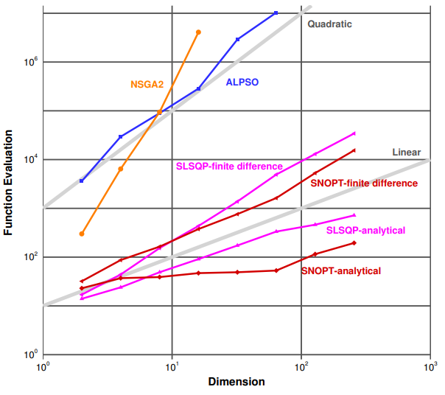
New Optimization Strategies: Framework Considerations
Flexible level of fidelity
Low fidelity analyses are useful but insufficient, especially for aerodynamics in this case
Shock formation, laminar-turbulent transition, combustion rates, etc. are highly nonlinear!
(Ideally) even capable of handling slightly nonconvex problems
“Curse of Dimensionality”
Gradient-based optimization is the only tractable approach to large problems
Method of gradient calculation
Computational complexity
Quality
Modern methods: second-order (Newtonish)
Dimensionality vs. Computational Cost
Figure reproduced from J. Martins, 2013, “A Very Short Course on Multidisciplinary Design Optimization”
Improvement here is the key!

Slide 26
Backup: What is Gradient-based Optimization?
Explain gradient based optimization vs gradient free

Slide 27
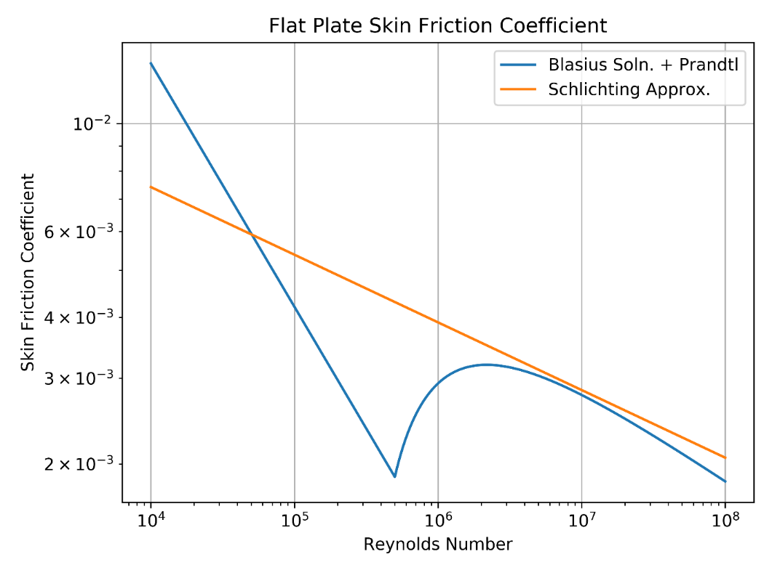
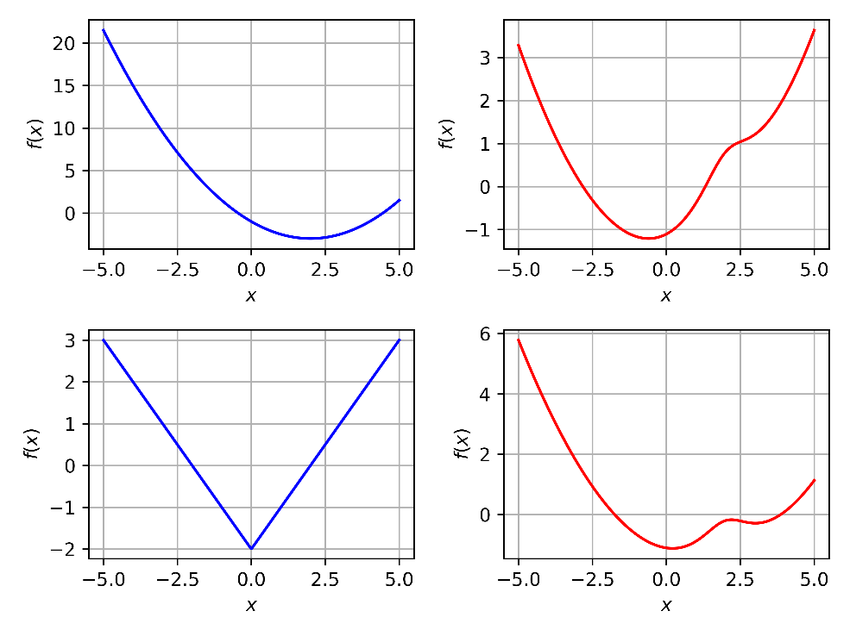
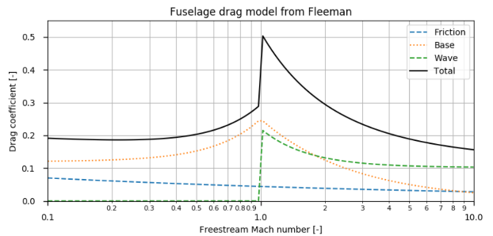
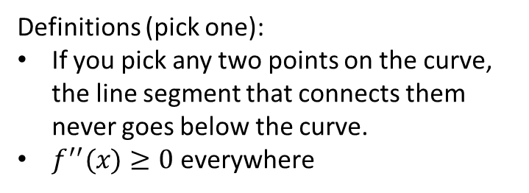
Backup: Convexity
Log-convexity
Many, but not all simple engineering models can be roughly approximated as log-convex
More complex models usually cannot
Convex and Nonconvex Functions
Definitions (pick one):
If you pick any two points on the curve, the line segment that connects them never goes below the curve.
$f^{′′}(x)≥0$ everywhere
Figure reproduced from M. Vernacchia, “Modeling Compress. Aero. Of Aircraft in GPs”

Slide 28
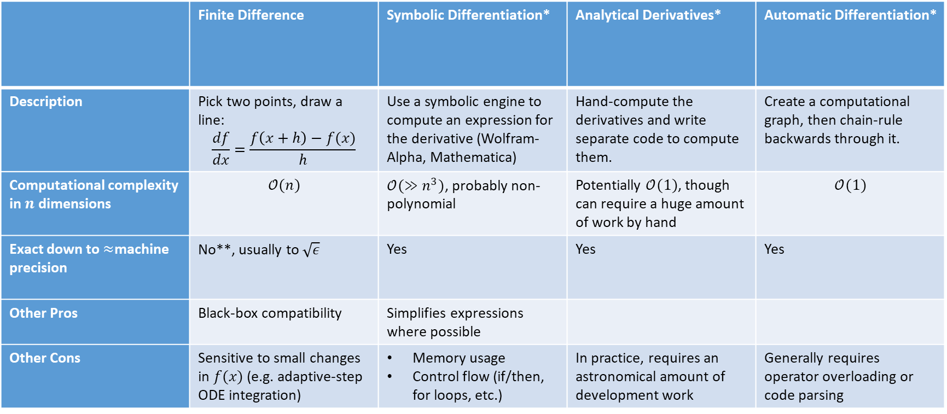
Backup: A Comparison of Gradient Methods
Method
 | Finite Difference | Symbolic Differentiation* | Analytical Derivatives* | Automatic Differentiation*
Description | Pick two points, draw a line: $$\frac{df}{dx}=\frac{f\left(x+h\right)−f(x)}{h}$$ | Use a symbolic engine to compute an expression for the derivative (Wolfram-Alpha, Mathematica) | Hand-compute the derivatives and write separate code to compute them. | Create a computational graph, then chain-rule backwards through it.
Computational complexity in $n$ dimensions | $$𝒪(n)$$ | $𝒪(≫n^{3})$, probably non-polynomial | Potentially $𝒪(1)$, though can require a huge amount of work by hand | $$𝒪(1)$$
Exact down to $≈$machine precision | No**, usually to $\sqrt{ε}$ | Yes | Yes | Yes
Other Pros | Black-box compatibility | Simplifies expressions where possible
Other Cons | Sensitive to small changes in $f(x)$ (e.g. adaptive-step ODE integration) | Memory usage Control flow (if/then, for loops, etc.) | In practice, requires an astronomical amount of development work | Generally requires operator overloading or code parsing
Figure of Merit
* Unfortunately, the names associated with different methods are not universally accepted by all fields – however, the names listed here reflect dominant trends.
** Complex-step finite differencing or higher-precision arithmetic can alleviate the accuracy issue, but these options are even slower and may not be as supported by numerical libraries.
Notes:
Consider dropping the last two rows

Slide 29
New Optimization Strategies: Automatic Differentiation
Automatic Differentiation (AD)
A method for computing gradients
Other names: “autograd”, “algorithmic differentiation”, “backpropagation” (machine learning)
Highly related to “adjoint formulations” in the PDE world
Why do we care?
Calculate the derivative with respect to ALL design variables for the cost of just one extra function call!
Gradients at machine precision
Higher-order gradients at same cost
Rapid, precise curvature information pairs well with modern nonlinear SQP-like optimization methods
Dimensionality vs. Computational Cost
Figure reproduced from J. Martins, 2013, “A Very Short Course on Multidisciplinary Design Optimization”

Slide 30
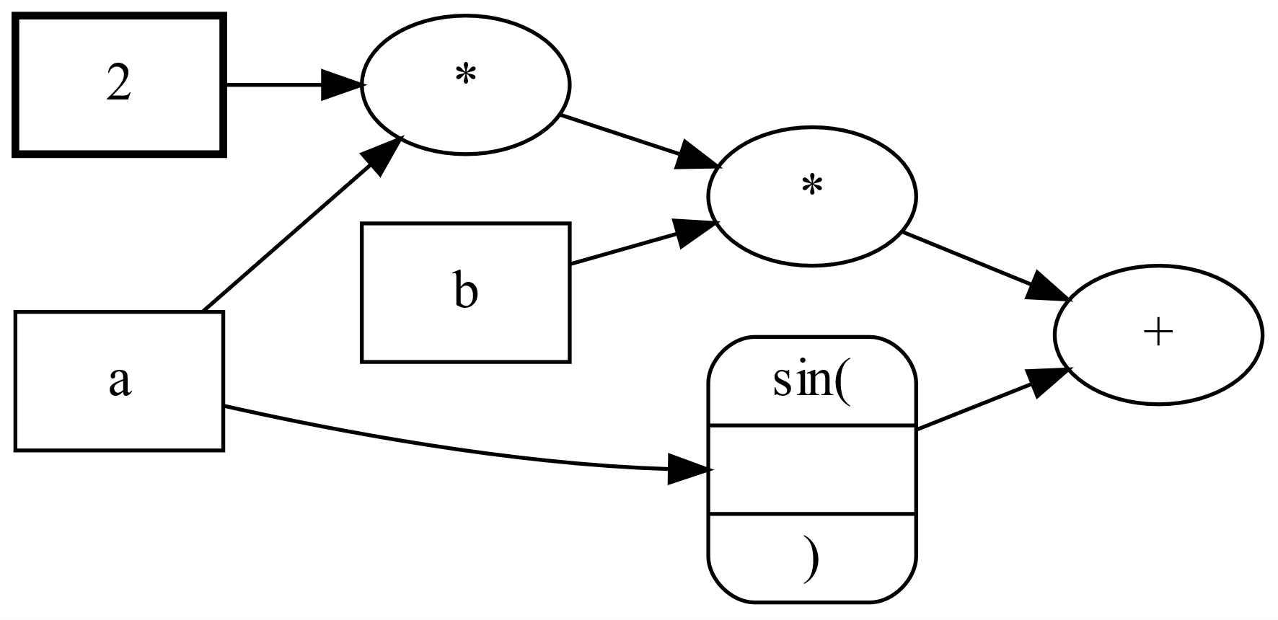

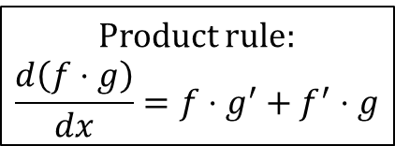
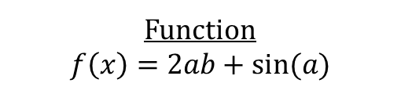
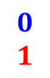
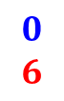
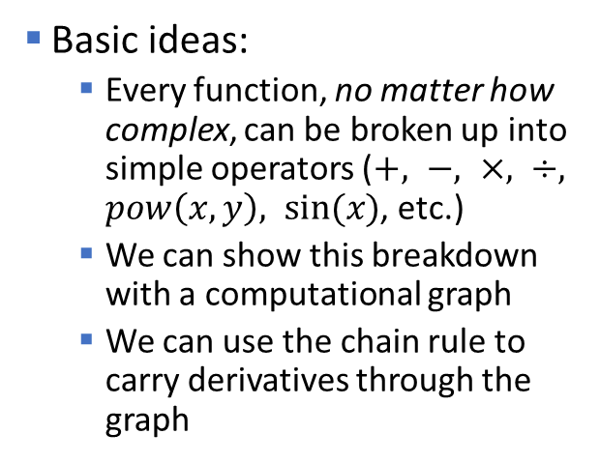
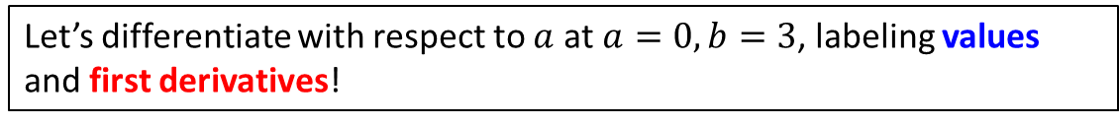
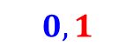

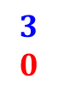
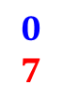
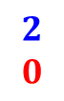
New Optimization Strategies: How does AD work
Function
$$f\left(x\right)=2ab+sin⁡(a)$$
Basic ideas:
Every function, no matter how complex, can be broken up into simple operators ($+, −, ×, ÷, pow\left(x,y\right), sin⁡(x)$, etc.)
We can show this breakdown with a computational graph
We can use the chain rule to carry derivatives through the graph
Computational Graph
Product rule:
$$\frac{d\left(f⋅g\right)}{dx}=f⋅g^{′}+f^{′}⋅g$$
$$2$$
$$0$$
$$0$$
$$2$$
$$0$$
$$6$$
$$3$$
$$0$$
$$0$$
$$7$$
$$0$$
$$1$$
$$0,1$$
Two flavors of AD
Forward mode
Cost scales with # of inputs
Reverse mode
Cost scales with # of outputs
Let’s differentiate with respect to $a$ at $a=0, b=3$, labeling values and first derivatives!

Slide 31
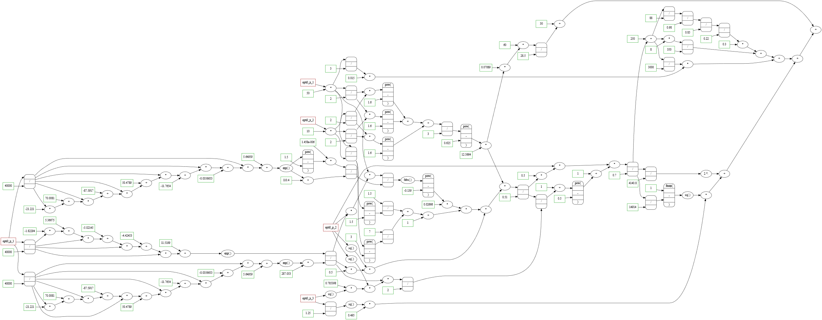
New Optimization Strategies: How does AD work
You can make a differentiable graph for ANY function!
Static vs. dynamic computational graphs
“tape”
Control flow (if/then, for loops)
Forward vs. reverse mode
Computational graph of mass calculation for a solar-powered blimp

Slide 32
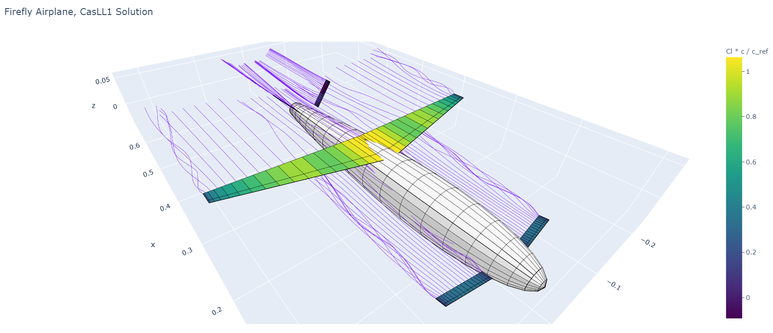
New Optimization Strategies: How does AD work
Differentiable physics models

Slide 33
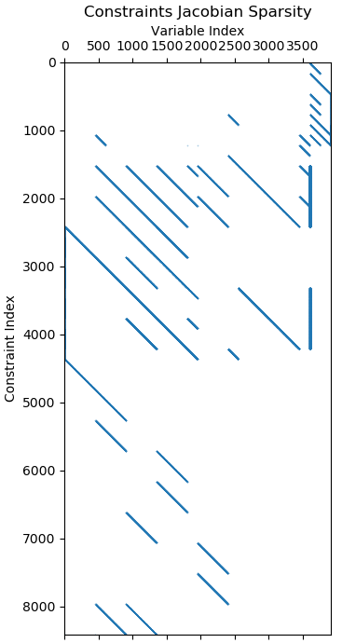

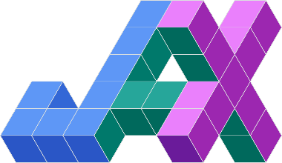

New Optimization Strategies: How does AD fit in
Automatic differentiation is provided through various machine learning and optimal control libraries, each with advantages:
PyTorch: fastest run speed, coupling first-order optimizers
CasADi: ODE integrators, coupling to second-order optimizers
JAX: fastest dev. speed; differentiates native NumPy code
Other factors
Sparse matrix representations
Loose cross-disciplinary constraints

Slide 34
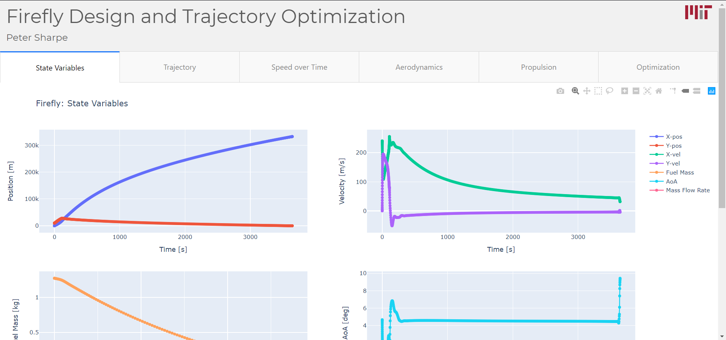
New Optimization Strategies: Missions Enabled

Slide 35
New Optimization Strategies: Missions Enabled
More stuff about interesting trades, design philosophies, things we’re sensitive to, etc.

